Slide 1
Regione Piemonte/Piedmont Region
Mario Gobello
Head of Territorial planning and local development, internal and urban areas Unit
qualificazionesviluppo@regione.piemonte.it
19 APRIL 2023 | Torino, Italy
Notes:
<numero>

Slide 2
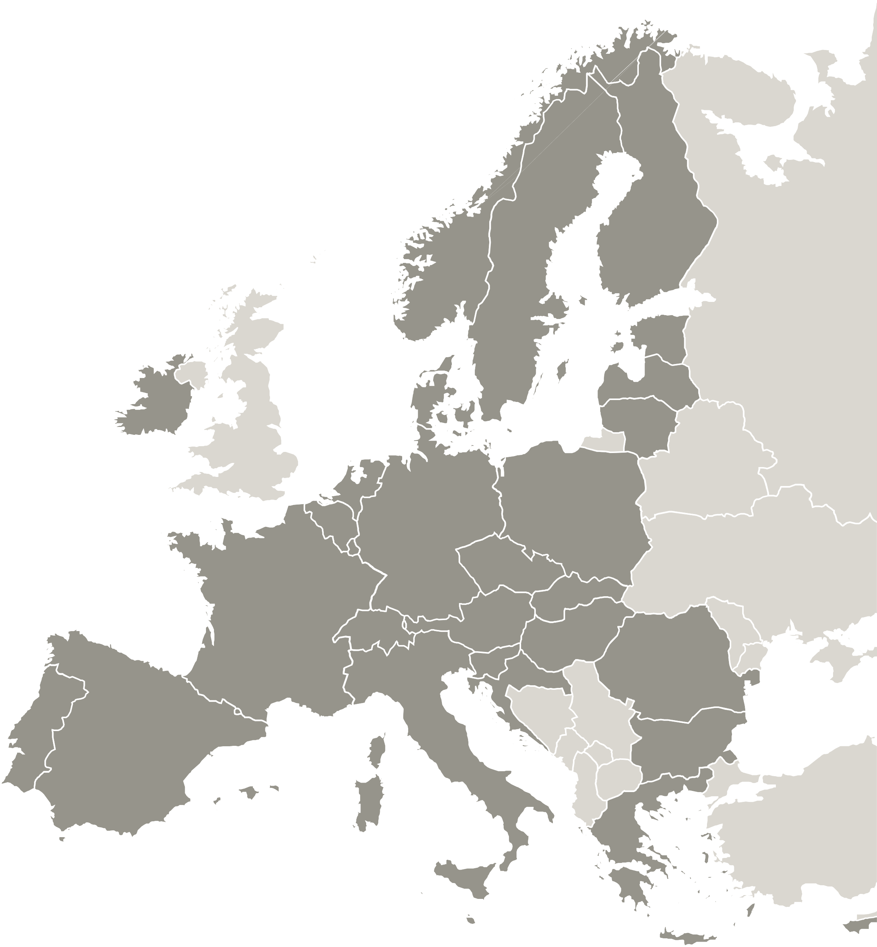
Regione Piemonte
POPULATION PEOPLE LIVING IN TORINO AREA
4.3 m 2.2 m
(7,3% OF THE NATIONAL TOTAL) (51% OF REGIONAL TOTAL)
GDP OVER
€ 136 bn 1000 Municipalities
(7.6% OF NATIONAL TOTAL) and 8 Main cities
The Urban system counts 230 Municipalities
(DeGURBA Degree of urbanisation classification Eurostat)

Slide 3
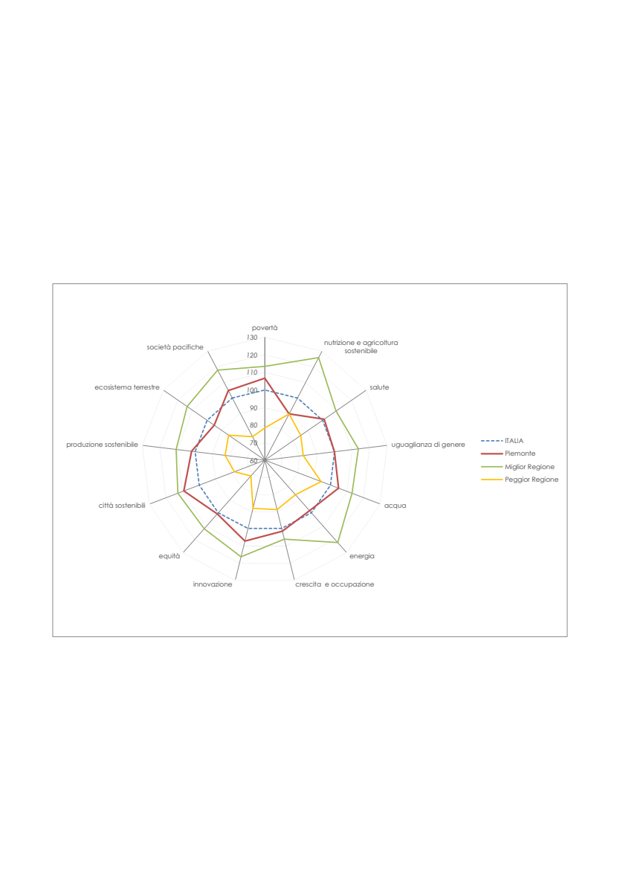
MAS3 – PRESERVE THE CULTURAL AND ENVIRONMENTAL HERITAGE AND THE RESILIENCE OF THE TERRITORIES
Regional Sustainable development Strategy
Goal 8 Piedmont remains among the regions most attentive to sustainability but is in 8th place ▲
Goal 6 Piedmont is doing well compared to "water" (high percentage of Wastewater treatment, high efficiency of distribution networks drinking water), 3rd place ▲
Goal 11 "sustainable cities" (low percentage of urban waste sent to landfills), 4th place; ▲
Goal 2 "sustainable agriculture" goes badly ▼
Goal 15 “Terrestrial ecosystem” (share of protected areas below the Italian average; high waterproofing of the soil by artificial cover – 15th place ▼).
Fonte IRES 2022 su dati Istat
Notes:
<numero>

Slide 4
Policy instrument
Regional Programme ERDF 2021-2027
Policy Objective 5: Europe closer to citizens by fostering the sustainable and integrated development of all types of territories
Priority investment: 1 Fostering the integrated and inclusive social, economic and environmental development, culture, natural heritage, sustainable tourism and security in urban areas
TOTAL
131 MEUR
Notes:
<numero>

Slide 5
?
What we have done?
The SUA is the further step of the Urban Agendas policy implemented under POR-FESR 2014-2020
the main beneficiaries were the 7 municipalities provincial capitals.
Aimed at:
Enhancing access to, and use and quality of ICT;
Supporting the shift towards a low-carbon economy in all sectors;
Preserving and protecting the environment and promoting resource efficiency;
Policy budget: 60 Meuro

Slide 6
?
What will we do?
Azione V.5i.1 Urban Areas Strategies (SUA)
The SUAs are configured as an urban and peri-urban development tool and consist of:
a mix of integrated and coordinated interventions with a multifunctional dimension related to one or more domains aimed to support:
medium-sized urban areas and territorial systems,
Turin Metropolitan Areas,
SUAs are proposed by groups of municipalities, aimed to support:
territorial renovation,
urban and ecological regeneration,
prevention and management of natural risks, including those committed to climate change
protection, enhancement and networking of the architectural, cultural, tourist
protection of natural heritage

Slide 7
Main challenges to be addressed within UrbanCOOP
The main challenge are:
to boost the territorial integration by creating an effective governance systems that enable policy coherence in the urban areas;
to address urban areas towards an holistic approach;
to re-focus territorial policies towards more tailor-made, locally-led and place sensitive approaches ;
to favour the concentration of investments;

Slide 8
Main challenges to be addressed within UrbanCOOP
HOW?
Sharing of responsibilities;
Controlling the planning process;
Promoting participative mechanisms, involving citizens at all stages of policymaking;
Ensuring a strong support from the regional authorities;

Slide 9
The Team
Giorgio Smeriglio
Participation to field visits dedicated to good practices exchange;
Content elaboration and contribution to projects outputs;
Policy learning process;
Contribution to methodology for strategic planning;
Rossana Borello
Project management;
Involvement of internal and external stakeholders;
Content elaboration and contribution to projects outputs; Mutual learning and knowledge transfer
Administrative and financial management of the project
Eloisa Rosanna Testa
Communication activities envisaged by the project
Involvement of internal and external stakeholders;
Organisation field visits dedicated to good practices exchange, project and stakeholder meetings
Content elaboration and contribution to projects
good practices identification
Project monitoring and support to activities reporting;
Mario Gobello
Head of Territorial planning and local development, internal and urban areas Unit
TOTAL
Notes:
<numero>

Slide 10
Thank you!
www.interregeurope.eu/ACRONYM

