Slide 2
11 faculties 35 researchers
Chemistry
Claudia Barolo, Giovanni Ghigo, Lorenzo Maschio, Lorenzo Mino, Marcello Baricco, Gabriele Ricchiardi, Marco Minella, Marta Corno, Michele Chierotti, Salvatore Baldino, Silvia Bordiga, Valter Maurino
Computer Science
Andras Horvath
Cultures, Politics and Society
Alessandro Sciullo
Economics and Statistics
Massimo Nicolazzi, Valeria Di Cosmo
Earth Sciences
Chiara Montomoli, Domenico De Luca, Franceco Dela Pierre, Gessica Umili, Giovanna Antonella Dino, Linda Pastero, Manuela Lasagna, Marcello Natalicchio, Nadia Curetti, Salvatore Iaccarino, Sergio Vinciguerra, Simona Ferrando
Interuniversity Department of Regional and Urban Studies and Planning
Giuseppe Mandrone
Law
Anna Porporato
Life Sciences and Systems Biology
Francesca Valetti
Management
Davide Calandra, Federico Lanzalonga, Paolo Biancone
Physics
Paolo Gambino
Veterinary Sciences
Leila Vincenti

Slide 3
Production
Electrochemical and photoelectrochemical production by water electrolysis
Photocatalytic production processes (water photosplitting, semiconductor oxides, reforming of organic compounds)
Mixtures rich in hydrogen for pyrogasification of organic materials (wood) and plastic
Biomass enzymes (bacteria, algae) by hydrogenase
Logistics (purification, distribution, storage, compression)
Identification and study of the geological characteristics (tightness, stability of voids, possible fluid / rock interactions) of sites for the storage of hydrogen in depleted reservoirs (quarries, mines) or ad hoc (salt formations, aquifers, hard rocks), including any effects induced in the facing areas
Synthesis and characterization of materials (hydrides, LOHC) for the storage of hydrogen
Compression of hydrogen by hydrides
LCA of hydrogen compression and storage processes

Slide 4
Fuel cells
Polymer membranes for PEM cells
Oxidic materials for SOFC
Digitalization
Data processing and use of data: visualization, statistical analysis and forecasts with probabilistic models or machine learning
Development of formal models based on data (of production processes, energy consumption, production from renewable sources)
Analysis, optimization of performance (scheduling based on green energy availability, optimal process parameters).

Slide 5
Industrial use
Use of hydrogen for the synthesis of light hydrocarbons by hydrogenation of CO2
Selective hydrogenations for fine chemistry (experiments and modeling)
Development of highly selective advanced catalysts for saving energy resources and precious materials
Energy use
Integration of hydrogen storage systems based on hydrides with electrolysers and fuel cells for storage of renewable energy
Chemical energy storage through the synthesis of light hydrocarbons to be used as fuel or basic chemical molecules and through selective hydrogenation of CO₂
Mobility use
Feasibility studies for the use of hydrogen mobility in the automotive, railway and nautical fields
Hydrogen storage systems for mobility applications
Hydrogen-powered fuel cell drones

Slide 6
Economic-financial, legal and regulatory, social perspective
Economic impact of the use of hydrogen on the electrical system and for mobility
Economic analysis of Hydrogen Valleys and EU taxonomy on the reduction of the cost of debt linked to green hydrogen
Analysis of competition scenarios based on patent portfolios, strategic positioning and new business models
Business Case on the development of hydrogen technologies
Analysis and evaluation of laws, incentives, regulations
Social acceptance of hydrogen-based technologies
Hydrogen for energy communities

Slide 7
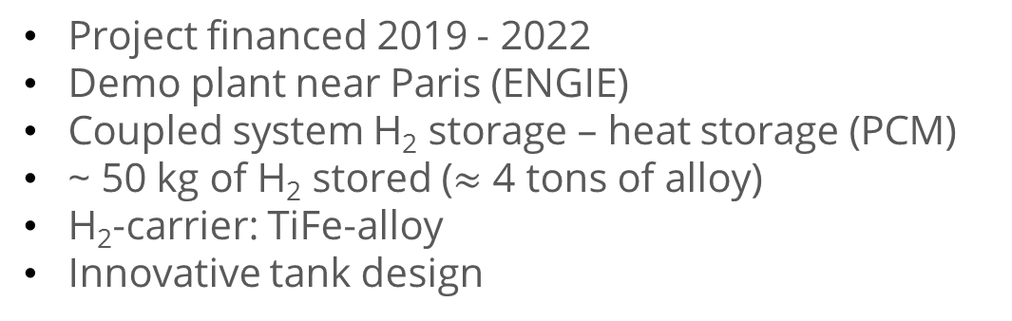
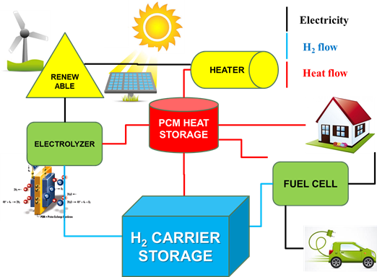

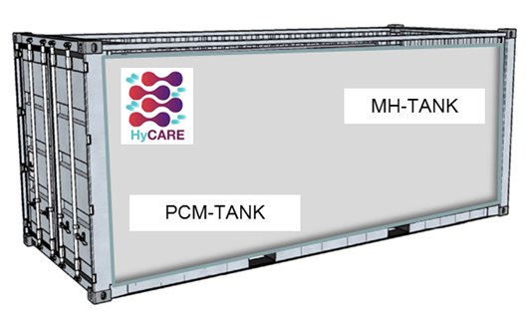


HyCARE: Hydrogen Carrier for Renewable Energy Storage
Storage of renewable energy through the conservation of hydrogen carriers and heat accumulation
European FCH JU funded project with several public and private partners

Slide 8

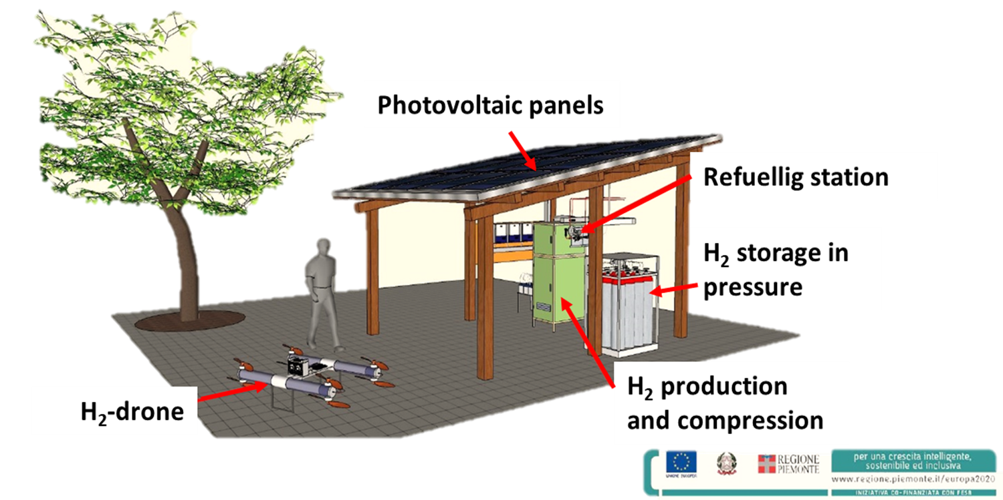
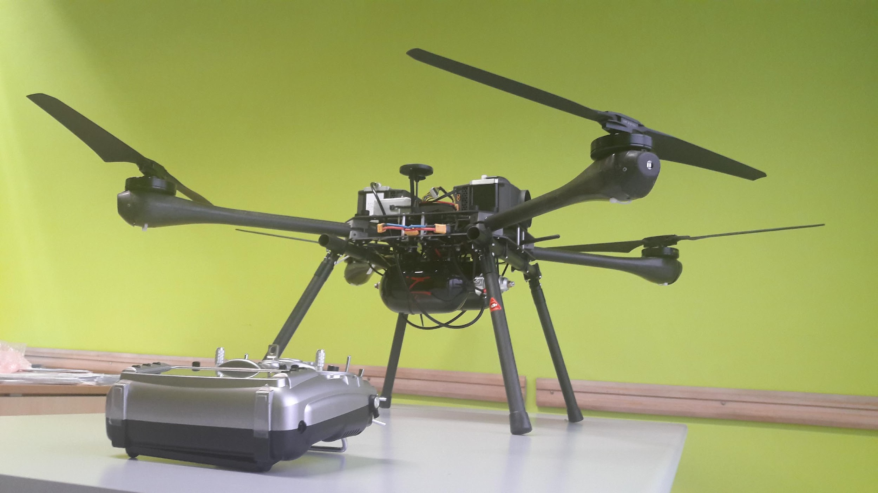
Clean-DronHy: H₂ powered drone with H₂ refuelling station
Produce, compress and use H₂ onsite
H₂-REFUELLING STATION
PV panels: 10 panels of 300 W
Electrolyser: 250 Nl/h of H₂ at 30 bar and T_{amb}
MH-Compressor: output pressure of 200 bar
Booster: from 200 to 400 bar
DRONE
Two bottles of 1 l or one of 3 l of H₂ - Type IV bottle
H₂ pressure = 300 bar
2 Fuel Cell : 650 W each
Battery - Consumption : 8 Nl/h
Time of flight : 1:00-1:30 h
Diameter = 1.3 m Weight = 5.6 kg
Regional funded project with SME private partners
Notes:
<numero>

Slide 9
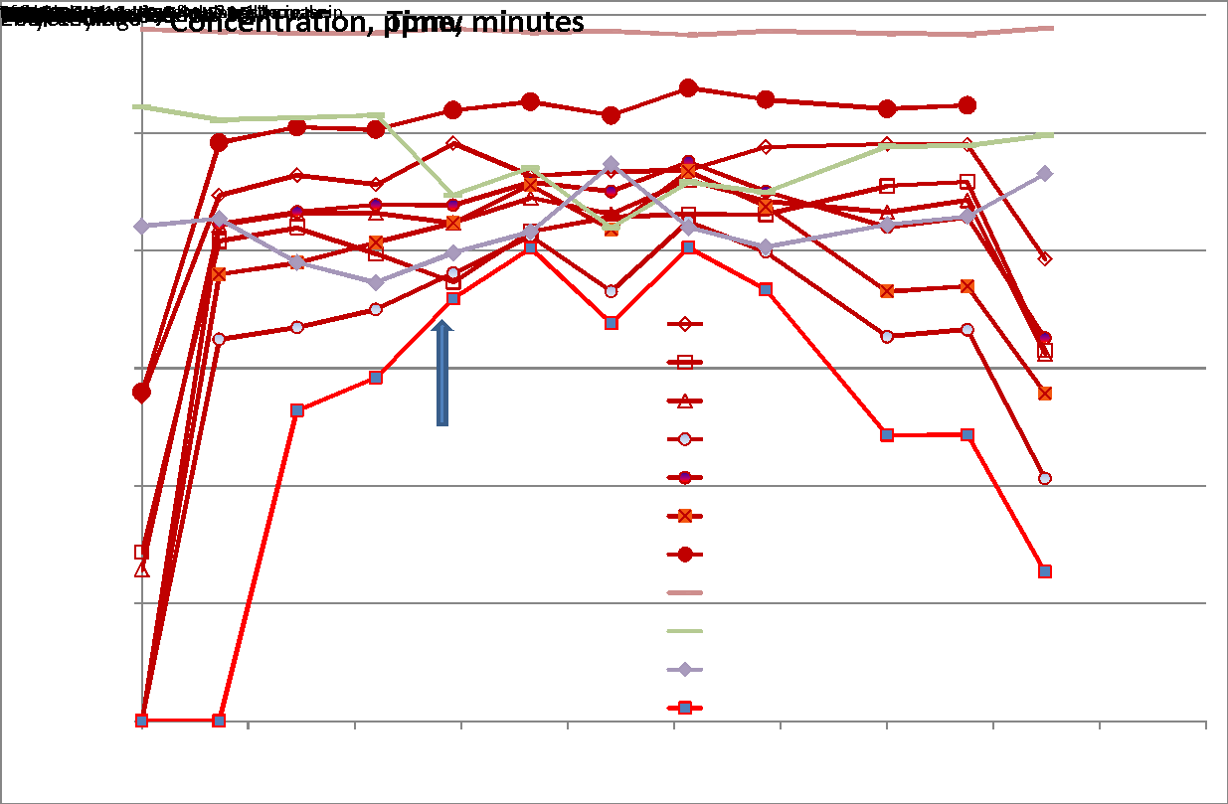
SmallGreenCHP4.0: Autonomous and connected cogeneration system for small users based on renewable biomass of local forest origin certified for the production of syngas with a high hydrogen content
SYNGAS STATION
Creation of an off-Line GC Station for syngas analysis
Creation of an on-line measurement station of the composition of syngas (CH4, H2, CO, CO2), pollutants (HCL, Tar, Particulate, H2S)
Regional funded project with SME private partners
Notes:
<numero>

Slide 10
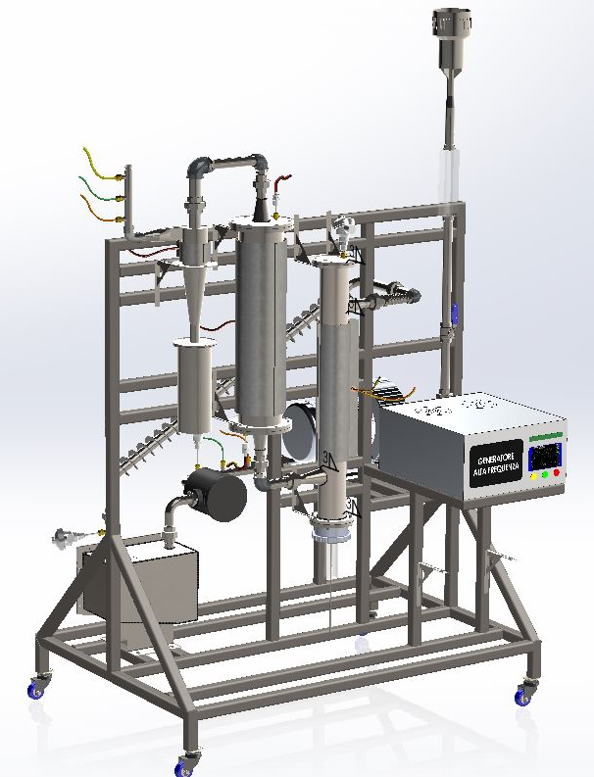
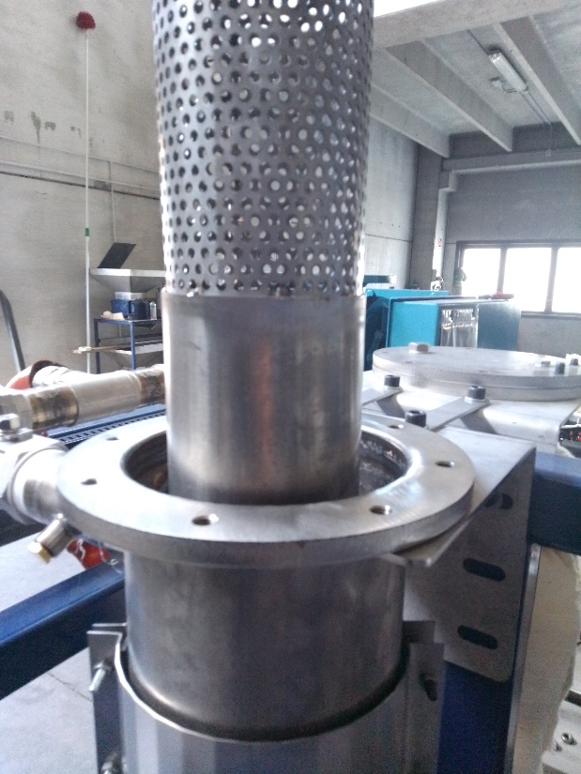
VI-R: SynGas conditioning system generated from hospital / marine waste for the abatement of sulfur, chlorinated and tar gases
PECO STATION
PECO is a complete gas cleaning unit placed on a mobile skid. The system is aimed at particulate abatement, dechlorination, desulfurization and tar reforming. The device couples reagents, catalysts and an innovative Plasma-Enhanced Catalytic Oxidation treatment for tar reforming.
GC ANALYSYS
Characterization of the device according to the operating parameters of the plasma through gas chromatography analysis of the gaseous components and of the tar and pollutants (H2S, HCl, Tar) present in the Syngas before and after the PECO Station
Regional funded project with SME private partners
Notes:
<numero>

Slide 11
Call identifier | Acronym | Project title
FCH2 JU CALL FOR PROPOSALS 2018 | HyCARe | An innovative approach for renewable energy storage by a combination of hydrogen carriers and heat storage - Prof. Marcello Baricco
H2020-LC-SC3-2018-NZE-CC | COMETS | COllective action Models for Energy Transition and Social Innovation– Prof. Dario Padovan
H2020-MSCA-ITN-2018 | PARACAT | Paramagnetic Species in Catalysis Research. A Unified Approach Towards Heterogeneous, Homogeneous and Enzyme Catalysis – Prof. Mario Chiesa
H2020-MSCA-ITN-2020 | CHASS | Cu-CHA zeolite-based catalysts for the selective catalytic reduction of NOx in exhaust diesel gas: addressing the issue of Sulfur Stability – Prof. Gloria Berlier
MSCA-IF-2020 | PLEC | Private Law and the Energy Commons – Prof. Alessandro Quarta
H2020-LCE-2016-RES-CCS-RIA | GEMex | GEMex: Cooperation in Geothermal energy research Europe-Mexico for development of Enhanced Geothermal Systems and Superhot Geothermal Systems – Prof. Giuseppe Mandrone
H2020-LC-SC3-2018-Joint-Actions-3 | Impressive | Ground-breakIng tandeM of transPaRent dyE SenSitIsed and peroVskite solar cElls – Prof. Claudia Barolo
H2020-LC-SC3-2018-NZE-CC | COZMOS | Efficient CO2 conversion over multisite Zeolite-Metal nanocatalysts to fuels and OlefinS – Prof. Silvia Bordiga
H2020-LC-BAT-2019 | MODALIS2 | MODelling of Advanced LI Storage Systems – Prof. Lorenzo Maschio
H2020-LC-SC3-EE-2019 | eCREW | establishing Community Renewable Energy Webs - Rolling out a business model and operational tool creating webs of households that jointly manage energy to improve efficiency and renewables uptake – Prof. Dario Padovan
H2020-LC-SC3-2020-Joint-Actions-1 | LEAP-RE | Long-Term Joint EU-AU Research and Innovation Partnership on Renewable Energy – Prof. Alessandro Sciullo
H2020-LC-SC3-2020-NZE-RES-CC | 4AirCRAFT | Air Carbon Recycling for Aviation Fuel Technology – Prof. Francesca Bonino
ERC-2019-SyG | CUBE | Unravelling the secrets of Cu-based catalysts for C-H activation – Prof. Silvia Bordiga
Notes:
<numero>

Slide 12

PhD programs for research on hydrogen
Chemistry and Material Sciences
Earth Sciences
Innovation for the Circular Economy
Master courses
Material Science
to learn about all PhDs at Unito

Slide 13

Electronic microscopy and EDS microanalysis
Transmission electron microscopy (TEM) with chemical microanalyzer in energy dispersion spectrometry (EDS)
Chemical analysis and material characterization
Structural characterization - NMR spectrometer
Gas Chromatograph Spectrometer (high resolution)
Closer Lab: decision analysis, based on economic incentives
To learn about all Research Labs at Unito

Slide 14








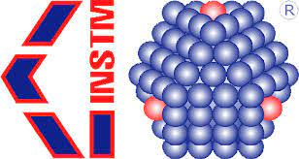



International and European
Italian
Piedmont Region and local

Slide 15








Slide 16


Bando PNRR “Ecosistemi dell’Innovazione”
NODES: Unito is a node of the Spoke “INDUSTRY 4.0 FOR SUSTAINABLE MOBILITY AND AEROSPACE”, led by Politecnico di Torino. The project covers among others the following topics:
Green Hydrogen Production and Storage
Synthetic fuels (also through CO₂ reduction with Hydrogen)

Slide 17
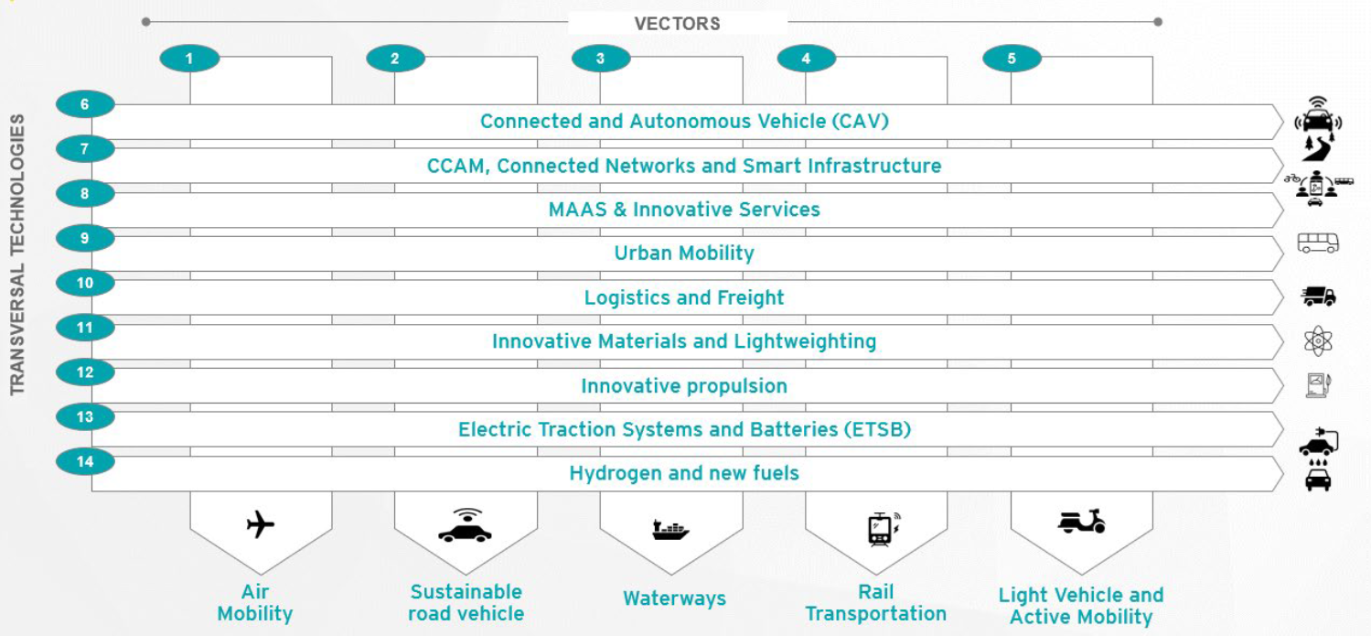
Hydrogen and new fuels

Slide 18
Major hydrogen activities will be located inside the Campus of the University of Turin Città delle Scienze e dell’Ambiente, which is undergoing an important expansion work, ending in 2024.
It will be one of the most important academic construction sites in our country in recent years.
The Campus will welcome 1,000 researchers and 10,000 students, to enhance knowledge in agri-food, biotech, green chemistry, mobility, energy, environment, human and animal health, material science.
Design with us the Scientific and Technology Area - Butterfly Area - of 50,000 sqm, that within the Campus, will host companies and organizations to make R&D together with our researchers and students, through joint labs, testing plants, access to research instruments and innovation services.
Apply to the Call for interest, contact butterflyarea@unito.it

Slide 19
interdisciplinarity
joint participation in funded projects
direct access to Labs and use of research tools
commissioned research (e.g. feasibility studies, new materials)
joint publications
sponsorship of doctoral scholarships
internships and theses
joint labs and pilot plants

Slide 20
Coordinator Group H2@Unito
Marcello Baricco
Industrial Liaison Office, Università degli Studi di Torino
staff.ricerca@unito.it

